Slide 1

Deep Learning
Presented By
Dr. Monika Arora, Ph.D

Slide 2

Agenda
Introduction to Data Science
Introduction to Artificial Intelligence (AI)
How we achieve AI
Introduction to Machine Learning
Limitation of Machine Learning
Artificial Neural Networks (ANN)
Deep Dive into ANN (Neurons, Layers, Activation Function, Optimisers)
Deep Dive into Tensor flow & Keras
Image Processing
Deep Dive into Convolution Neural Networks
Deep Dive into Recurrent Neural Network
Deep Dive into Long Short Term Memory
Deployment
Hands-On

Slide 3

Data Science
It is a study to understand the logic behind the behaviour of data
Logic could be pattern, mathematical formula or equation
Bring hidden insight on surface and help to take informed decision

Slide 4










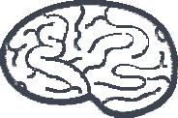



Artificial Intelligence
When machines start thinking like humans and help in taking decision
Machine Learning
Natural Language Processing
Robotics
Deep Learning
Reinforcement Learning
Rule Based

Slide 5

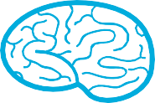





Artificial Intelligence Contd…
MACHINE LEARNING
It deals with system or algorithms to learn
relationships between input and output and identify hidden patterns
DEEP LEARNING
It’s a special branch of
Machine Learning where machine learns relationships between input and output using process used by human brain
NATURAL LANGUAGE PROCESSING
It’s a branch that deals with understanding the human language
REINFORCEMENT LEARNING
For a speciﬁc situation what best possible path or behaviour a program will take get result
ROBOTICS
Transformers movie – when machines behave like human beings
RULE BASED
“If this than this” approach

Slide 6

Impact of AI on Business
Personalized Experience
Increase revenue
Automate Routine Process
Human Error minimized
Cost Savings
Faster Business Decisions
Increase productivity & operational eﬃciencies
Predict customer preference
Fast New Customer Acquisition

Slide 7
Machine Learning
Unsupervised and Supervised Learning
Machine learning is an application of artificial intelligence (AI) that provides systems the ability to automatically learn and improve from experience without being explicitly programmed.
Unsupervised learning is a type of machine learning algorithm used to draw inferences from datasets consisting of input data without labelled responses.
Supervised learning is inferring from labelled training data.

Slide 8
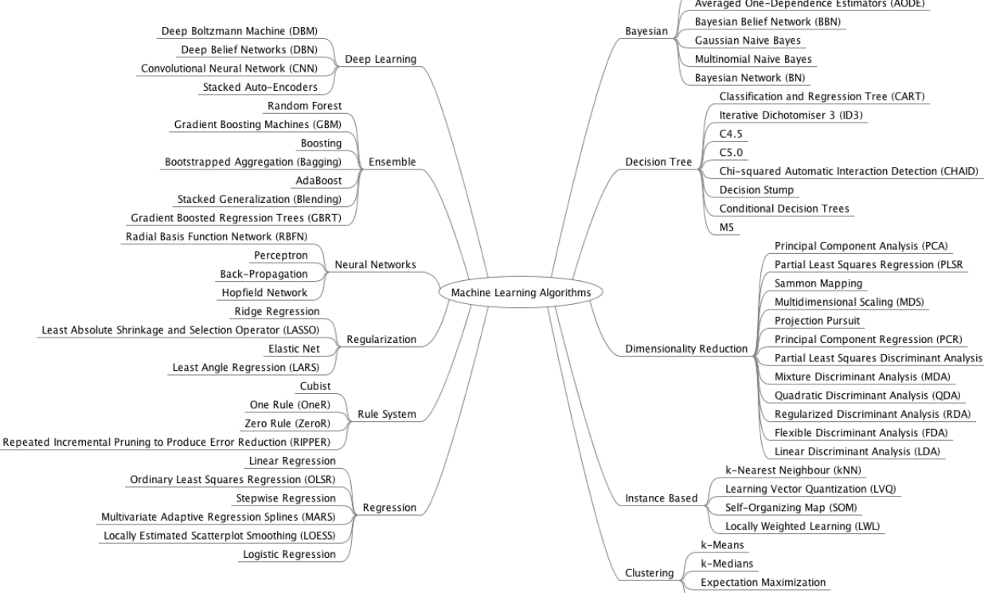

Slide 9
Use Cases of ML
Automotive – Driverless cars
Banking – Opportunity to product new market, balance risk and detect fraud
Government – Enhance security and threat detection
Manufacturing – Product defects, Predictive Maintenance, Operational Efficiencies.
Retail – Continuous monitoring of consumer behaviour, Micro segmentation, product recommendation
Education – Career selection, Online teaching
E-commerce – Recommendation System, Last Mile Delivery, Customer engagement

Slide 10

Challenges with Machine Learning
Data Integration and Preparation
Feature Extraction - Combining the original features (e.g., variables) into a smaller set of more representative features
Feature Selection - Selecting only the most meaningful original features to be used in the modeling algorithm
Feature Engineering - Combining pre-existing features in a data set with one another or with features from external data sources to create new features that can make models more accurate

Slide 11
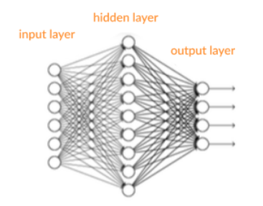
Artificial Neural Networks
It’s a supervised learning system built of neurons or perceptrons
Neurons, connected with each other via interconnected layers, process data to drive information
A shallow neural network has only three layers
An Input Layer
Hidden Layer
Output Layer

Slide 12

Important Terms in ANN
Inputs – Source data from external world and fed into the system
Output – Prediction in terms of real value (probabilities) or Boolean numbers
Neurons/Perceptron – Basic unit of neural network which accept an input data, process it and make prediction
Activation function - Help generate output values within an acceptable range and include the non-linearity component
Weight Space – An optimal set of numeric number which help in measuring the value of an output

Slide 13
Important Terms in ANN Contd…
Forward Pass – Takes the data, passes it through the network and allows each neuron to process the data
Error Function – Defines how far the actual output of the current model is from the correct output.
Backpropagation– Moving data back from the network’s prediction to the neurons that generated that prediction
Bias and Variance - Bias measures how well the model fits the training set. Variance measures how well the model works with unknown inputs that were not available during training
Hyperparameters– A setting that affects the structure or operation of the neural network.

Slide 14
Perceptron
It’s functioning is replica of human brain
Emulate the neurons
Ability to learn and solve complex problems
10
Wo
Constant
Weight Sum
Activation Function
X1
W1
Output
Input
X2
W2
Xn
Wn

Slide 15
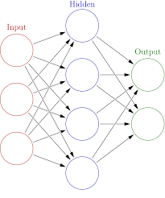
Artificial Neural Network Principle
There are 4 principle object of ANN
There are 3 layers (Input, Hidden and Output)
Input data is called Features and Output data is called Labels
The performance of the learning phase is measure by Loss Function metric
Optimizer is used in improving the learning of ANN

Slide 16

ANN Architecture
Layers
All learning take place inside layers
It is comprised of Neurons (weights)
A Neuron is decomposed into input and activation function
A typical ANN is called fully connected layers
The input data is in form of Vector(Input) and Scalar(Labels)
Activation Function – The function is used to learn the non-linear pattern. It defines the output on the given set of inputs.
The list of most used Activation function is
Rectified Linear Unit (ReLU)
Sigmoid
Tanh
Leaky ReLU
Loss Function – Used to estimate the performance of the optimizer.
For Binary Classification – Cross Entropy
For Linear Regression – Mean Square Error
Optimizer - The optimizer will help improve the weights of the network in order to decrease the loss.
Types of Optimizer are
Stochastic Gradient Descent
Momentum Optimization
AdaGrad
Adam Optimization

Slide 17
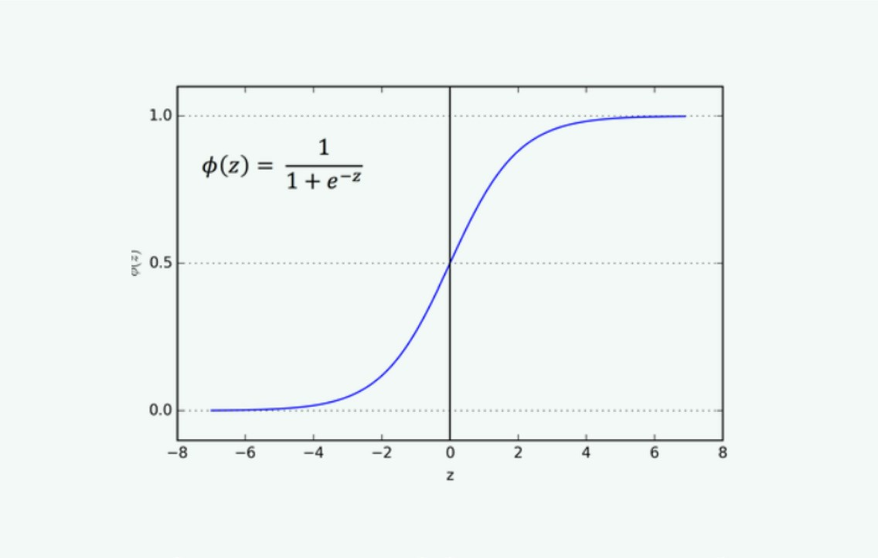

Sigmoid
Also called Logistic Activation function
It gives output between 0 and 1
Is used to predict the probability of an output
The function is diﬀerentiable that means we can ﬁnd slope of the sigmoid curve
Its monotonic but its diﬀerential is not monotonic. This can cause a neural network to get stuck at the training time.

Slide 18
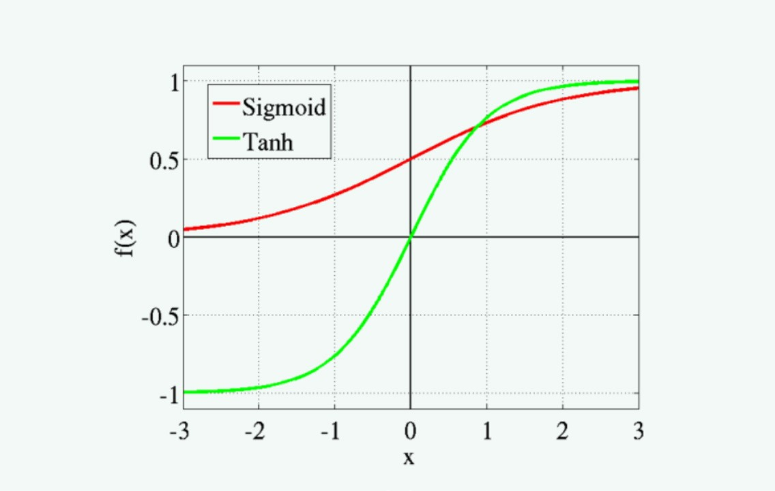

Tanh
Also called Hyperbolic Tangent Activation Function
The range of tanh is -1 to 1 Its also S shaped
The negative inputs will be mapped strongly negative and the zero inputs will be mapped near zero in the tanh graph
The function is diﬀerentiable
The function is monotonic while its derivative is not monotonic

Slide 19
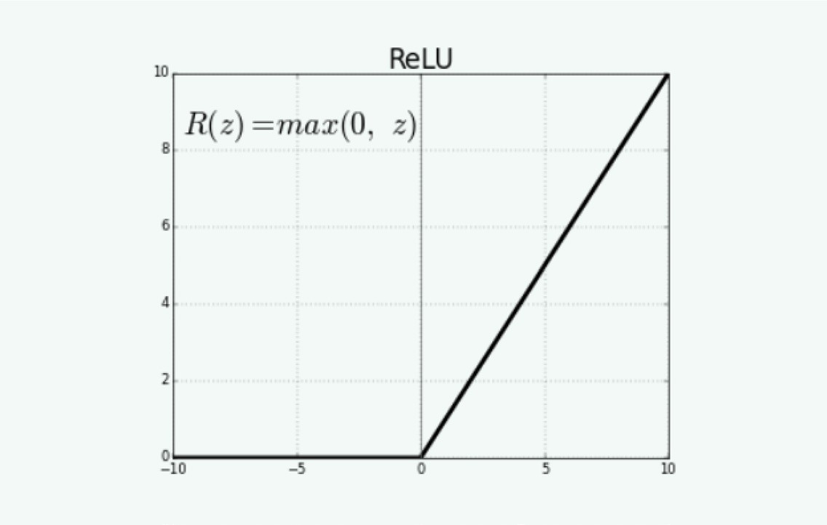

ReLU
Rectiﬁed Linear Unit Activation Function
It’s the most used activation function Range is 0 to inﬁnity
The function and its derivative both are monotonic
Negative input given to the ReLU activation function turns the value into zero immediately in the graph

Slide 20
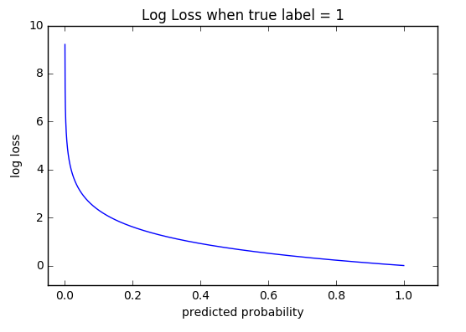
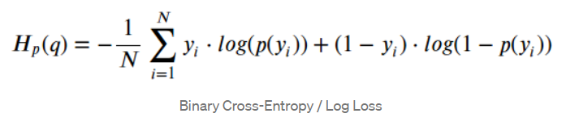
Loss Function – Cross Entropy
Cross-entropy loss, or log loss, measures the performance of a classification model whose output is a probability value between 0 and 1
Cross-entropy loss increases as the predicted probability diverges from the actual label.
Predicting a probability of .012 when the actual observation label is 1 would be bad and result in a high loss value.
A perfect model would have a log loss of 0

Slide 21

Stochastic Gradient Descent
Stochastic Gradient Descent
A gradient is the degree of change of a parameter with the amount of change in another parameter.
It’s a convex function. Looks like the letter “U”
The more the gradient, the steeper the slope.
Gradient Descent is an iterative method which is used to find the values of the parameters of a function that minimizes the cost function as much as possible.
There are three types of Gradient Descent
Batch Gradient Descent
Stochastic Gradient Descent
Mini-batch Gradient Descent
Stochastic - A system or a process that is linked with a random probability.
Few samples are selected randomly instead of the whole data set for each iteration.

Slide 22
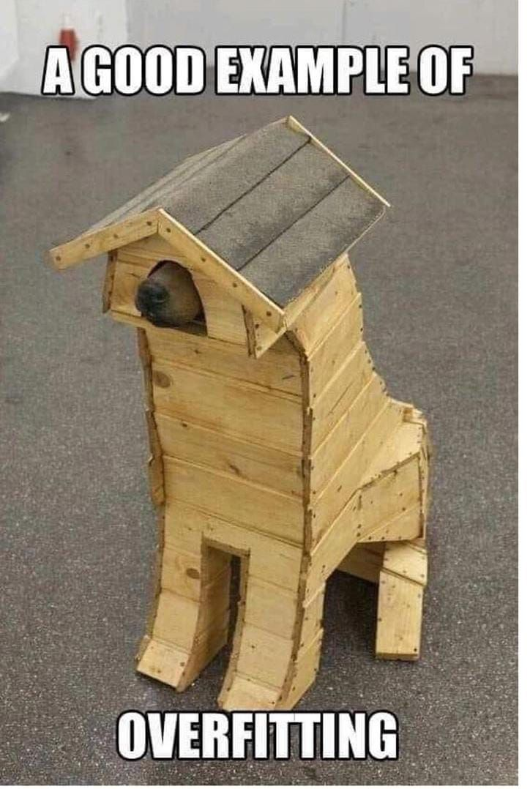
Limitation of ANN
Overfitting
Can’t generalised new data
Generate biased prediction
Ways to Overcome Overfitting
Weight Regularization - Add constraints to the weights of the network
L1: Lasso: Cost is proportional to the absolute value of the weight coefficients
L2: Ridge: Cost is proportional to the square of the value of the weight coefficients
Network Size - Start with a small amount of layer and increases its size until we find the model overfit
Dropout - Some weights will be randomly set to zero using dropout rate

Slide 23
Image Analytics
The process of processing Text, Images and Videos which comprise of 80% of data in enterprise
The List of application around us
Analyse Mood
Security Threat
Detect Machine Failure
Recognize handwritten content
Vehicle Number plate reader

Slide 24

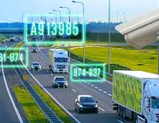
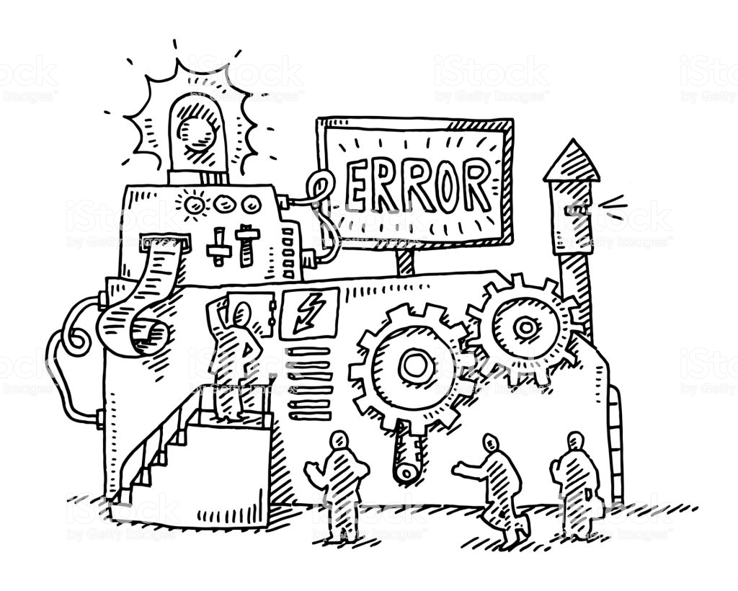

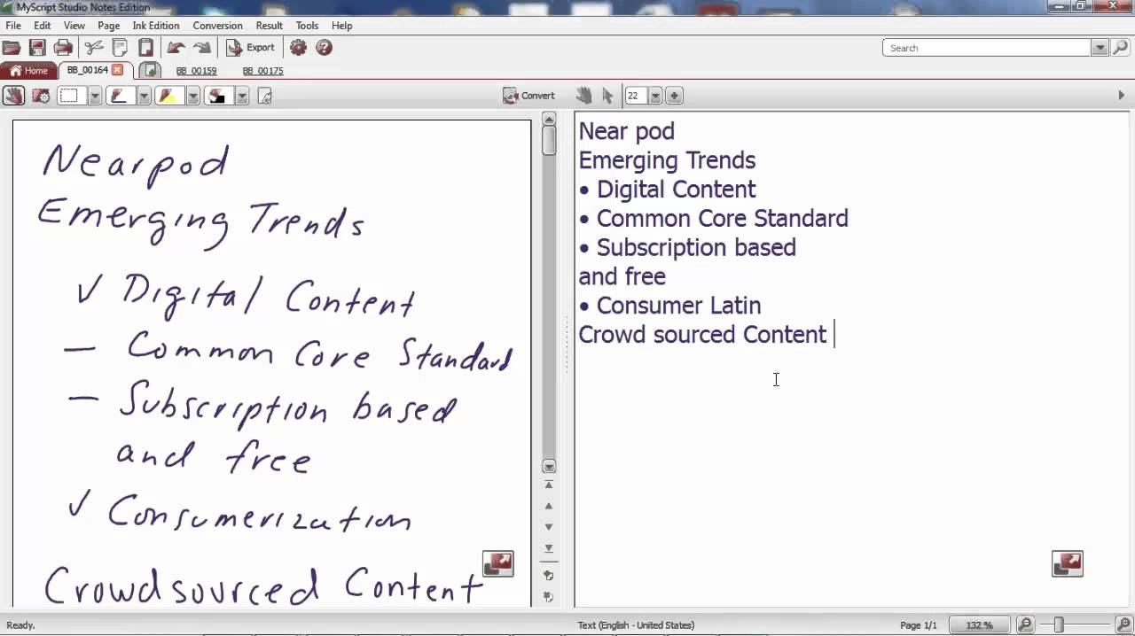
Image Analytics - Overview

Slide 25

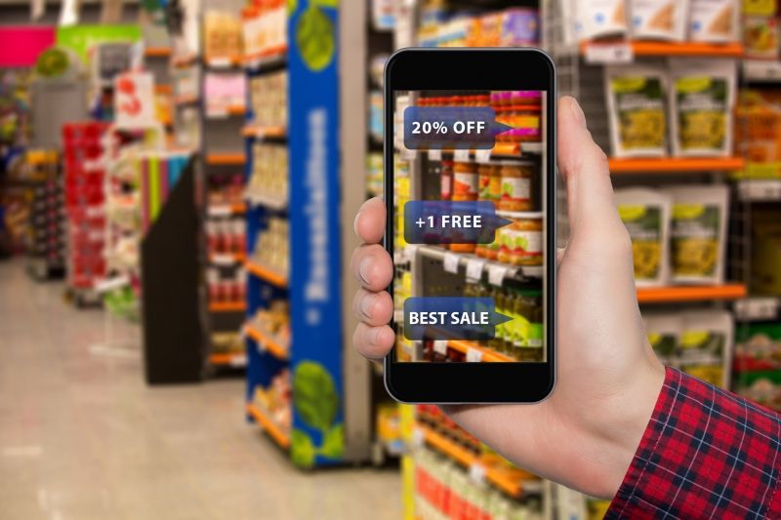

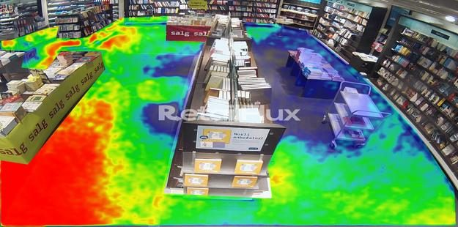

Use Cases in Retail Industry

Slide 26
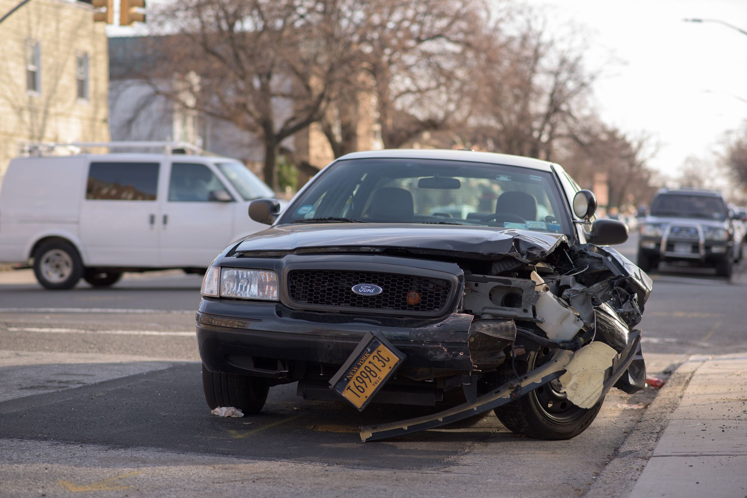

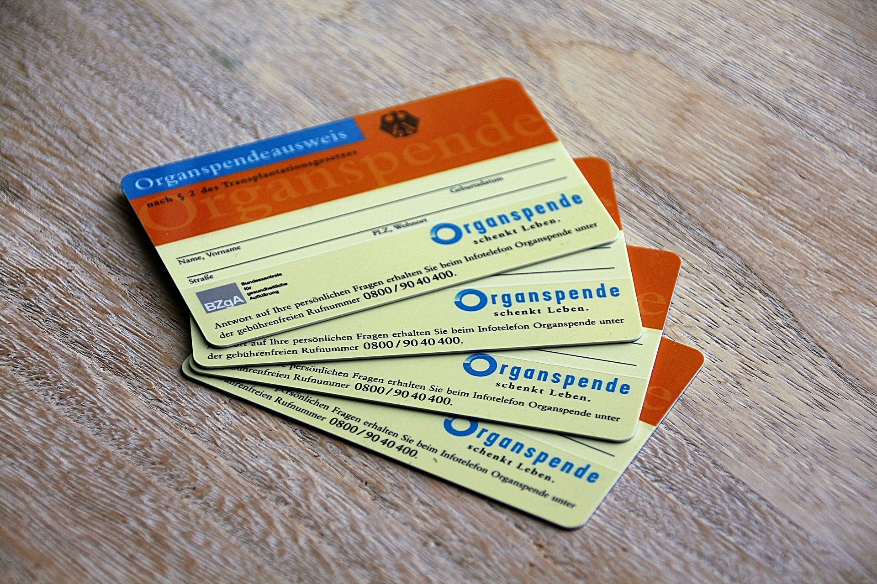

Use Case in Insurance Industry

Slide 27
Healthcare
Image Analytics helps radiologists find abnormalities in patient scan images that could lead to a diagnosis when interpreted
List of Use Cases
Precise Diagnoses - Algorithms trained using a huge amount of image data can detect the slightest presence of a condition which may typically be missed out by human
Timely Detection of Illness - Pattern Recognition help in detecting early symptoms of cancer
Heightened Medical Process - Lessen the time doctors usually take in analysing reports and images.
Medical Imaging – Conversion of 2D scan images into interactive 3D models enable medical professionals to gain a detailed understanding of a patient’s health condition.
Health Monitoring - Measure the body fat percentage of people using images taken from regular cameras.

Slide 28
Computer Vision
The ability of computer to function as human eyes
Integrate with laptops, mobiles phones, Tabs and CCTVs
Every minute 1.78 million GB data gets produced online
A big chunk that of data is images and videos.

Slide 29
Open CV
Computer Vision library
Open Source
Cross Platform
Develop real-time computer vision application
C++, Python and Java interface
Uses HaaR cascade files for object detection.

Slide 30

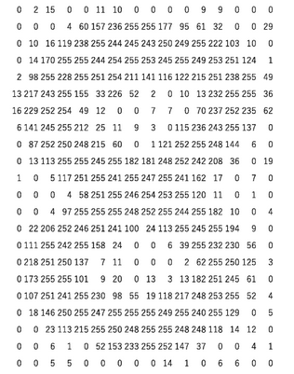

Image Processing

Slide 31
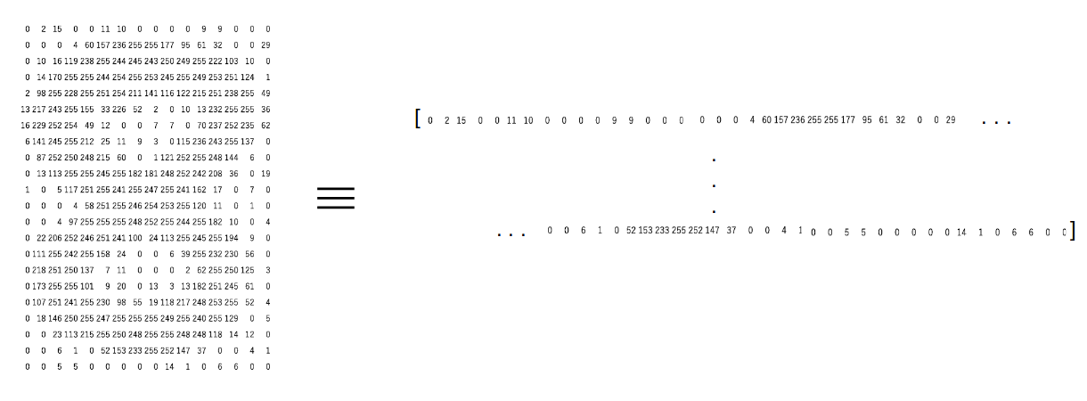
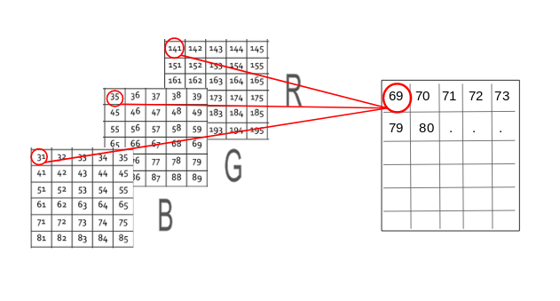
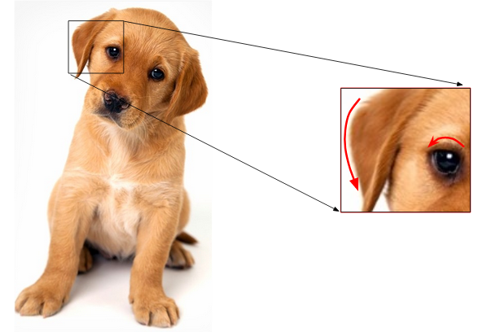
Feature Extraction
Grayscale Pixel Values as Features
Raw pixel values as separate features.
Mean Pixel Value of Channels
Generate a new matrix that has the mean value of pixels from all three channels (R,G,B)
Extracting Edge Features
Identify sharp change in the colour

Slide 32
TensorFlow

Slide 33
TensorFlow Introduction
Developed By Google Brain Team
To accelerate Machine Learning and Deep Neural Network research
Opensource Framework
Can run on multiple CPU, GPU and Mobile devices
Wrappers are written in Java, C++ and Python
Tensors = multi dimensional array
Flow = Flowchart of operations called graphs
Very fast at computing the matrix multiplication because it is written in C++

Slide 34
Popular Use Cases
Gmail
Google Photos
Google Search Engine
Speech recognition
Image recognition
Object tagging videos
Self-driving cars
Sentiment analysis
Detection of flaws
Text summarization
Mobile image and video processing
Air, land, and sea drones

Slide 35
List of Companies got benefit from TensorFlow
Airbnb – Improve the guest experience by classifying images and detect object at scale
Airbus –Monitor changes on earth surface for urban planning, mapping landscapes and damages due to catastrophes
Carousell – Improve buyer and Seller experience by building ML models with images and NLP
GE Healthcare – Identify anatomy on MRIs of the brain
PayPal - Fraud Detection using TensorFlow
Twitter – Ranking Tweets
Kakao – Predict the probability of trip completed rate when dispatch driver to fulfil ride hailing requests
CocaCola – Proof- of Purchase capability
China Mobile – Detect network anomalies and verify operations logs

Slide 36
Tensor - A tensor is a vector or matrix of n-dimensions that represents all types of data.
Node - The node carries the mathematical operation and produces an endpoints outputs.
Edges - The edges explain the input/output relationships between nodes.
Shape - Its a dimensionality of the matrix or array
Graph – All operations are conducted successively in graph
TensorBoard - It is used to visualize TensorFlow graph, plot quantitative metrics about the execution of graph, and show additional data like images that pass through it.
TensorFlow Components
Var 1
Addition
Var 2

Slide 37
Tensors
Every Tensors has three main properties
Unique Label (name)
Dimension (shape)
Data Type (dtype)
Four types of Tensors
tf.Variable
tf.constant
tf.placeholder
tf.SparseTensor

Slide 38
TensorFlow Mathematical Operations
Following is a list of commonly used operations.
tf.add(x, y)
tf.substract(x,y)
tf.multiply(x,y)
tf.div(x,y)
tf.pow(x,y)
tf.exp(x)
tf.sqrt(y)
tensor_x = tf.constant([[5,9]], dtype = tf.int32)
tensor_y = tf.constant([[30, 14]], dtype = tf.int32)
tensor_add = tf.add(tensor_x, tensor_y)
print(tensor_add)
Tensor("Add:0", shape=(1, 2), dtype=int32)
tensor_multiply = tf.multiply(tensor_x, tensor_y)
Tensor("Mul:0", shape=(1, 2), dtype=int32)
Important : The tensors should have same shape

Slide 39
TensorFlow Variables
Variables represent the nodes where values change.
tf.get_variable(name = "", values, dtype, initializer)
argument
- name = "": Name of the variable
- values: Dimension of the tensor
- dtype: Type of data. Optional
- initializer: How to initialize the tensor. Optional
If initializer is specified, there is no need to include the `values` as the shape of `initializer` is used.
var1 = tf.get_variable("var", [1, 2])
print(var1.shape)
(1, 2)
var_1 = tf.get_variable("var_1", [1, 2], dtype=tf.int32, initializer=tf.zeros_initializer)
print(var_1.shape)

Slide 40
TensorFlow Placeholder
Placeholder are used to feed the tensor
Feed_dict is used to pass value to placeholder
Placeholder are feed in sessions only
tf.placeholder(dtype,shape=None,name=None )
arguments:
- `dtype`: Type of data
- `shape`: dimension of the placeholder. Optional. By default, shape of the data
`name`: Name of the placeholder. Optional
placeholder_x = tf.placeholder(tf.float32, name = "data_placeholder_a")
print(placeholder_x )
Tensor("data_placeholder_a_5:0", dtype=float32)

Slide 41
Session
Execute the operations
Operators are run inside the session
Session can run independently or within block
#Independent
sess = tf.Session()
result = sess.run(addition)
print(result)
sess.close()
#Block Auto close Session
with tf.Session() as sess:
result = multiply.eval()
print(result_2)

Slide 42
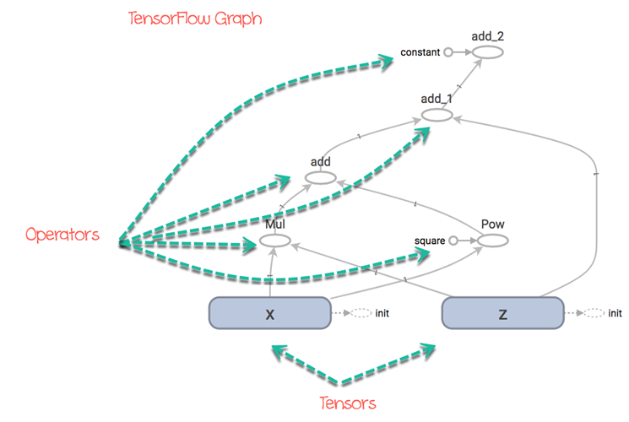
Graph
A graph is a convenient way to visualize how the computations are coordinated.
All mathematical operations performed inside graph
Nodes represent the mathematical operations
The graph has two components
Node – represent operation
Edge – Its the tensor
Graph doesn’t display the output of the operation
Its is used to visualise the connection between operations
F(x,z) = xz + x^2 + z +5
https://www.guru99.com/tensor-tensorflow.html

Slide 43

List of Algorithms Supported
Linear regression: tf.estimator.LinearRegressor
Classification:tf.estimator.LinearClassifier
Deep learning classification: tf.estimator.DNNClassifier
Deep learning wipe and deep: tf.estimator.DNNLinearCombinedClassifier
Booster tree regression: tf.estimator.BoostedTreesRegressor
Boosted tree classification: tf.estimator.BoostedTreesClassifier

Slide 44
TensorFlow Implementation
Load Data in Memory - Load all data into memory as a single array.
Load Data in Pipeline - TensorFlow has built-in API that helps to load the data, perform the operation and feed the machine learning algorithm easily.

Slide 45
Keras

Slide 46

Keras Overview
Runs on top of open source libraries such as Tensorflow, Theano or CNTK etc
With minimal structure we can create powerful deep learning model using Keras
Keras contains list of modules that have pre-defined classes, function, variables used in deep learning

Slide 47
List of available Modules
Initializers
Regularizers
Constraints
Activations
Losses
Metrics
Optimisers
Callback
Text Processing
Image Processing
Sequence Processing
Backend
Utilities

Slide 48
Deep Learning
A special branch of Machine learning where features are automatically extracted by the algorithm.

Slide 49
Applications
Image Classification
Semantic Parsing and Question Answering
Paraphrase Detection
Language Generation and Multi-document Summarization
Machine Translation
Speech Recognition
Character Recognition
Spell Checking
Text Classification and Categorization
Conversation Bot

Slide 50
List of Companies Got benefitted with Deep Learning
SALESFORCE – San Francisco, California
Created a platform called Einstein to simplify artificial intelligence and improve customer experiences with smarter and more personalized service.
H20.AI – Mountain View, California
Created the H2O Driverless AI platform that facilitates the delivery of expert data science.
DESCARTES LABS - Santa Fe, New Mexico
Data-refinery on a cloud-based supercomputer for the applications such as disease control, disaster mitigation, food security and satellite imagery.
TWOSENSE.AI – New York
A mobile SaaS security product applies machine (and deep) learning to eliminate authentication challenges and prevent fraudulent activity in biometric

Slide 51
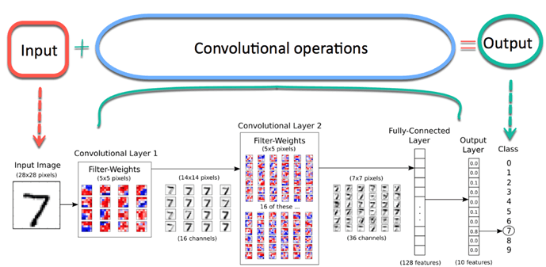
Convolutional Neural Network (CNN)
A well-known method in Computer Vision
Best for Image Processing such as detecting object from images/Video
Image- An array of Pixels with height and width

Slide 52
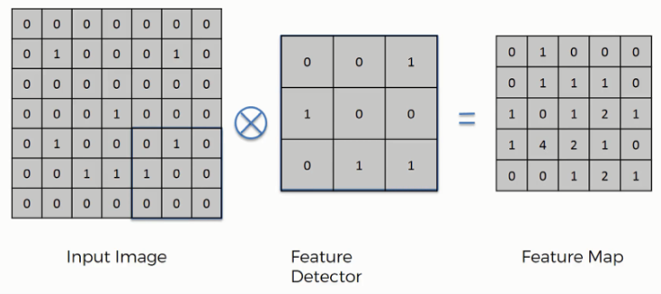
Components of CNN
There are four components of CNN
Convolution –
Extract features from the object on the image locally.
Learn specific patterns with in the pictures
Computer scan a part of the image (3x3 matrix)
Multiples the scanned part with filter and build feature map
Repeat the multiplication for complete image scan

Slide 53
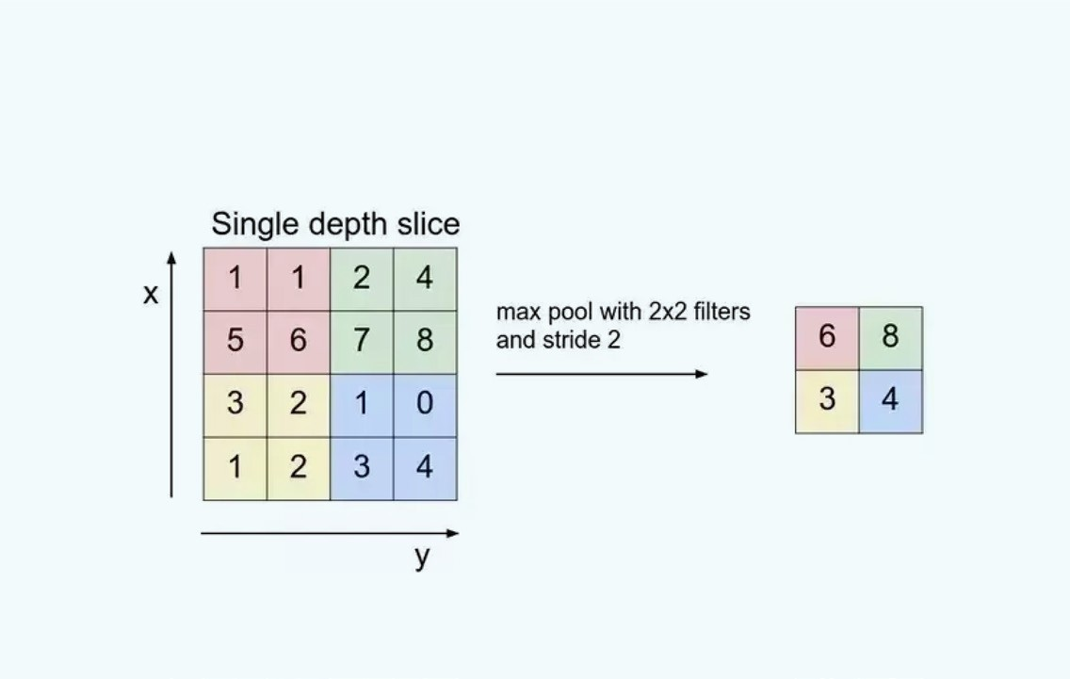
Components of CNN contd…
Activation Function
Add non-linearity component
Mostly ReLU is used as activation function
All –ev values replaced with 0
Max-Pooling
Reduce dimensionality of input image
Reduce the computational complexity of the operation
Prevent Overfitting
Returns maximum value from sub-matrix
Fully Connected Layer
. Build ANN
. Apply Sigmoid activation function
. Classify the image

Slide 54
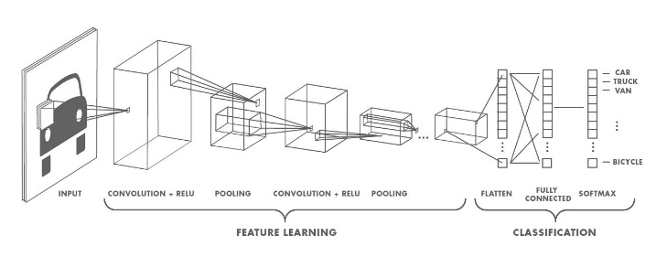
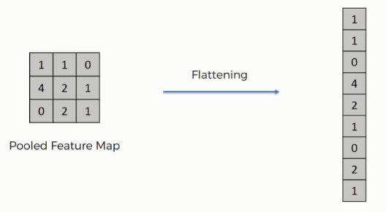
Activation Function
Add non-linearity component
A value is passed through a function that squashes the value into a range
Mostly ReLU is used as activation function
All –ev values replaced with 0
Flatten Layer
Fully Connected Layer
. Build ANN
. Apply Sigmoid activation
function
. Classify the image

Slide 55
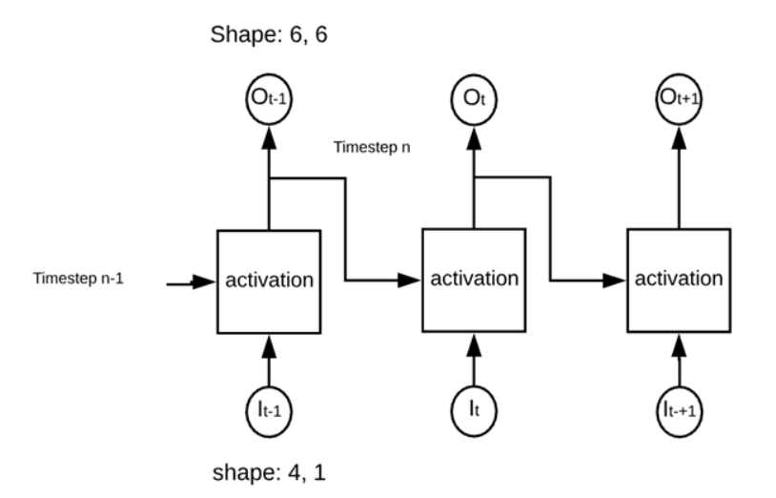
RNN (Feedback)
Similar to traditional ANN with an added Memory State to the neurons.
It is able to ‘memorize’ parts of the inputs and use them to make accurate predictions.
They deal with sequential data to make predictions.
TimeStep - Output is sent back to itself number of time
The network is called 'recurrent' because it performs the same operation
The network computed the weights of the inputs and the previous output before to use an activation function.

Slide 56

How RNN Works ?
Input an example from a dataset.
The network will take that example and apply some complex computations to it using randomly initialised variables (called weights and biases).
A predicted result will be produced.
Comparing that result to the expected value will give us an error.
Propagating the error back through the same path will adjust the variables.
Steps 1–5 are repeated until we are confident to say that our variables are well-defined.
A predication is made by applying these variables to a new unseen input.

Slide 57
Application of RNN
Predicting stock prices
Anticipating the trajectory of the vehicle
Machine Translation
Sentiment Analysis
Chat Bots

Slide 58
Limitation of RNN
Less efficient when timestep is large
Untrainable when many deep layers
Vanishing Gradient Problem - The gradients grow smaller when the network progress down to lower layers. So no change in gradient and Neural Network stops learning
This means that the network experiences difficulty in memorizing words from far away in the sequence and makes predictions based on only the most recent ones
Solution – LSTM

Slide 59
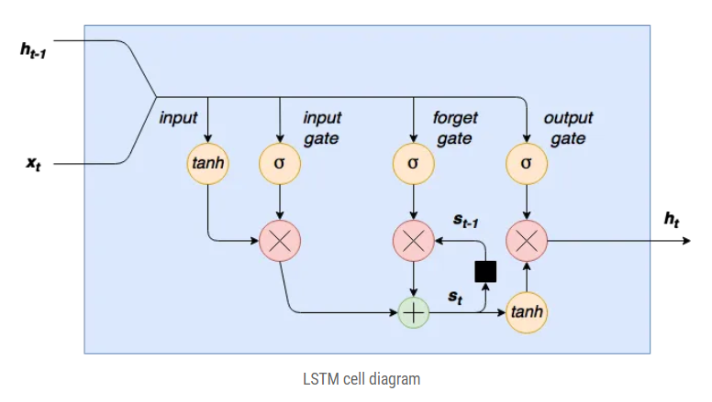

Long-Short Term Memory (LSTM)
Extension to RNN
LSTM’s enable RNN’s to remember their inputs over a long period of time
LSTM can read, write and delete information from its memory.
It learns over time which information is important and which not.
LSTM keeps the gradients steep and therefore the training relatively short and the accuracy high.
Ref : https://colah.github.io/posts/2015-08-Understanding-LSTMs/

Slide 60
How LSTM Works ?
Squashed via tanh
Sigmoid to Kill Off
Remember/Forget
Cell State - It runs straight down the entire chain, with only some minor linear interactions.
The LSTM does have the ability to remove or add information to the cell state, carefully regulated by structures called gates.
Gates are a way to optionally let information through. They are composed out of a sigmoid neural net layer and a pointwise multiplication operation.
Control Output
Reduce the risk of Vanishing Gradient

Slide 61
Thank You

